Slide 1
CST401 ARTIFICIAL INTELLIGENCE
MODULE 5

Slide 2
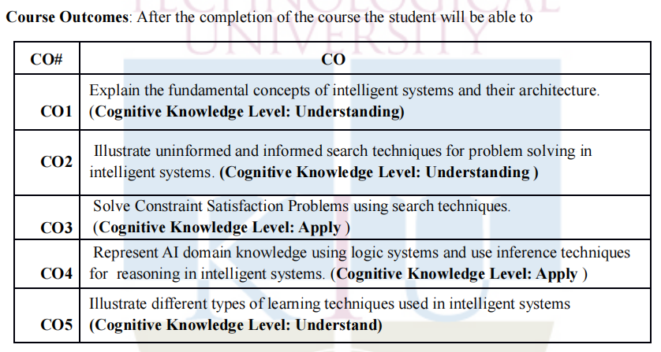
Course Outcome

Slide 3
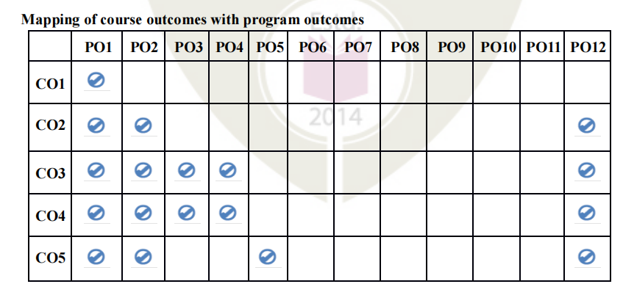
Mapping of course outcomes with program outcomes

Slide 4
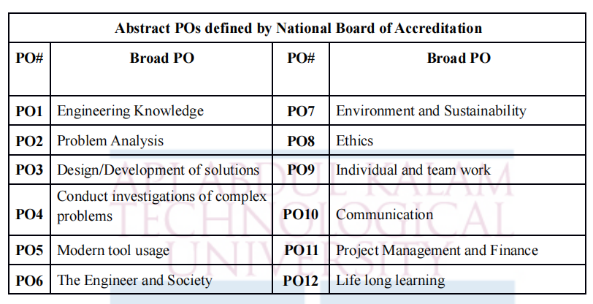
Abstract POs defined by National Board of Accreditation

Slide 5
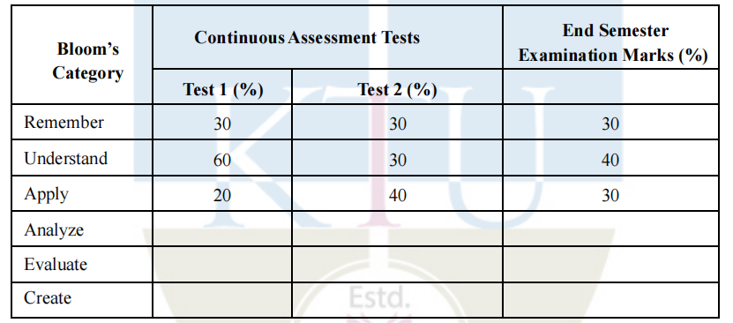
Assessment Pattern

Slide 6
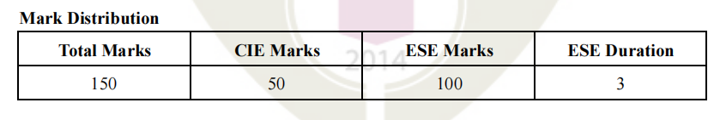
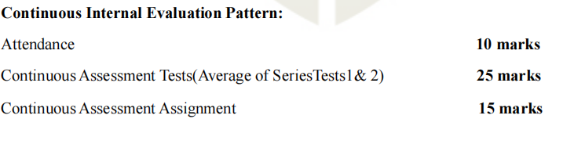
Mark Distribution

Slide 7
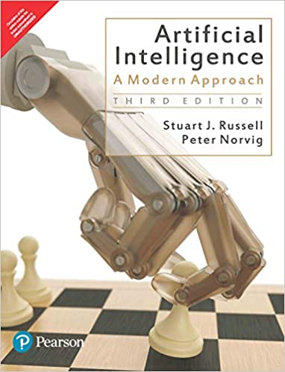
Textbook
Stuart Russell and Peter Norvig. Artificial Intelligence: A Modern Approach, 3rd Edition. Prentice Hall.

Slide 8
SYLLABUS- Machine Learning
Learning from Examples –
  Forms of Learning,
  Supervised Learning,
  Learning Decision Trees,
  Evaluating and choosing the best hypothesis,
  Regression and classification with Linear models.
CO5: Illustrate different types of learning techniques used in intelligent systems
(Cognitive Knowledge Level: Understand)
PO1-Engineering Knowledge
PO2 Problem Analysis
PO5 Modern tool usage
PO12 Life long learning

Slide 9
Learning From Example
Agents that can improve their behavior through diligent study of their own experiences

Slide 10
Learning
An agent is learning if it improves its performance on future tasks after making observations about the world

Slide 11
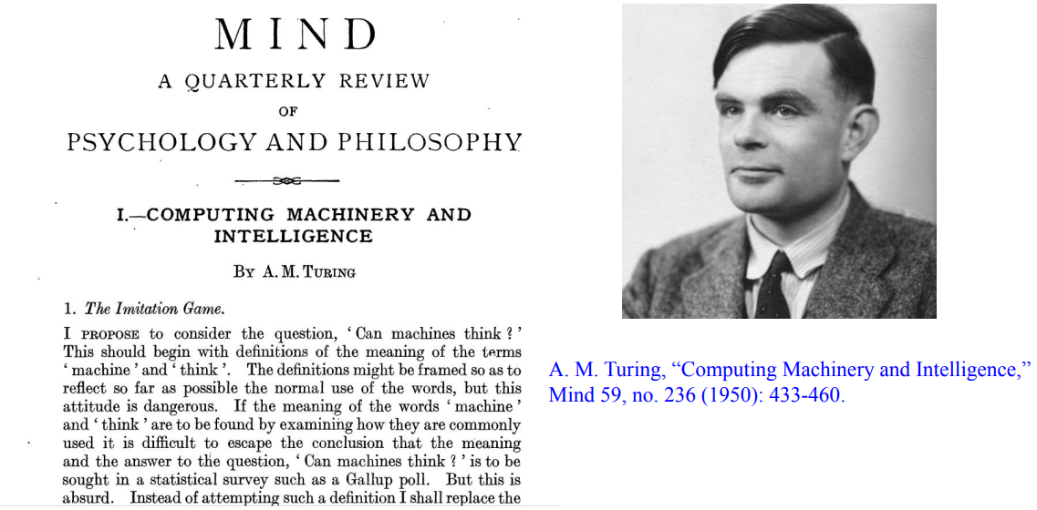

Slide 12
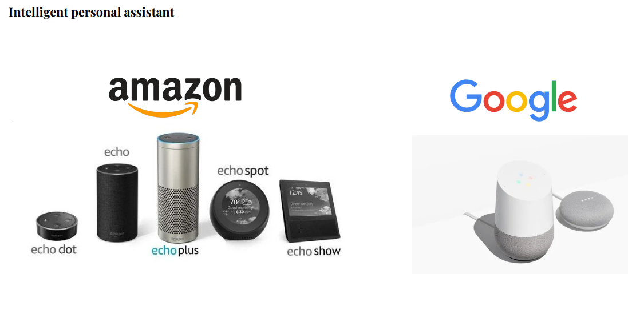

Slide 13


Slide 14
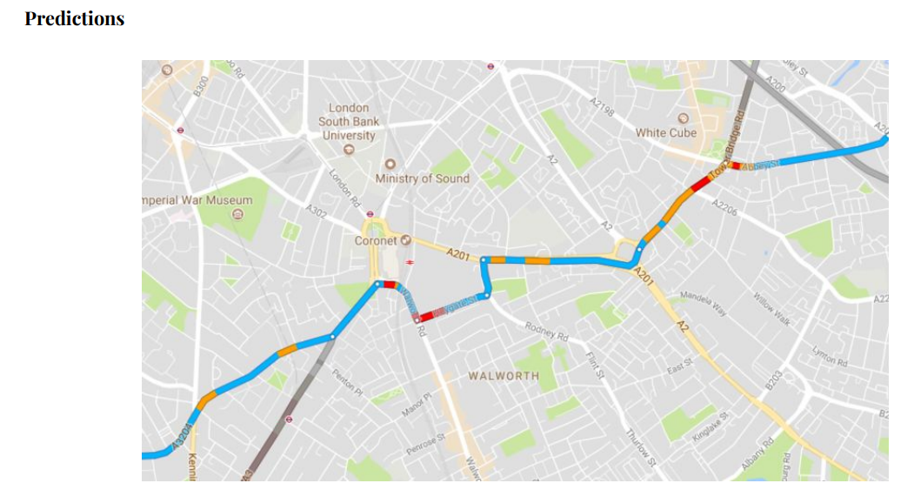

Slide 15
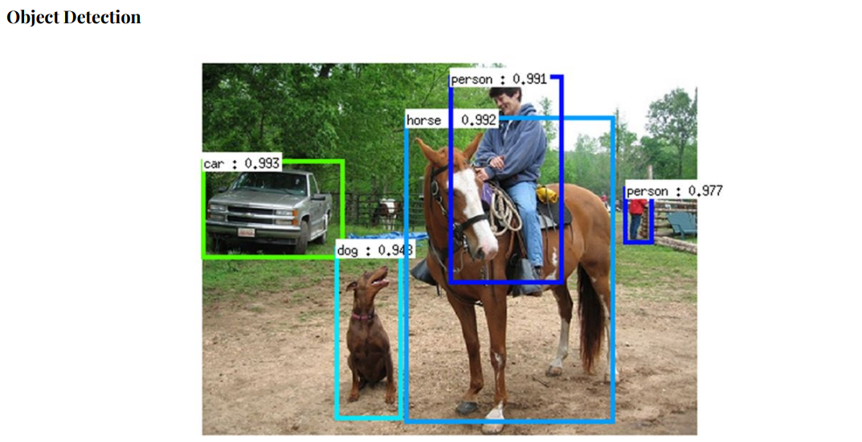

Slide 16


Slide 17
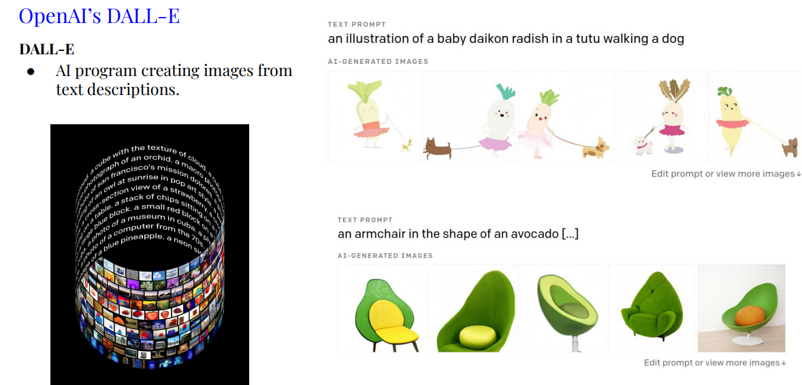

Slide 18
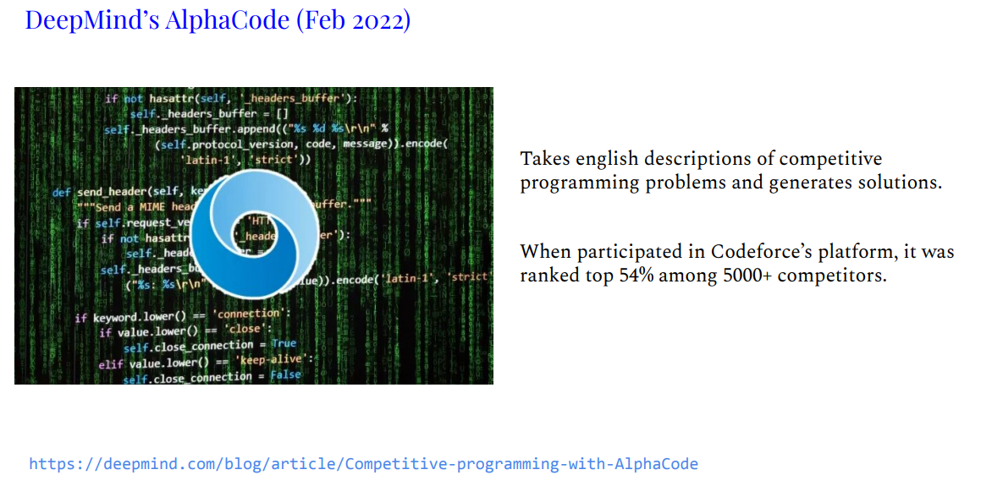

Slide 19
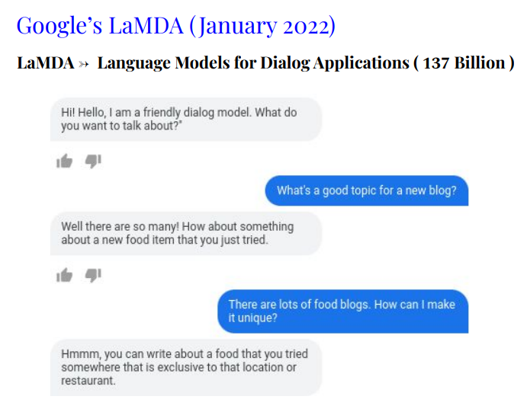
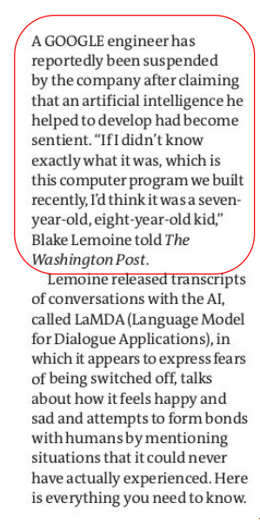

Slide 20
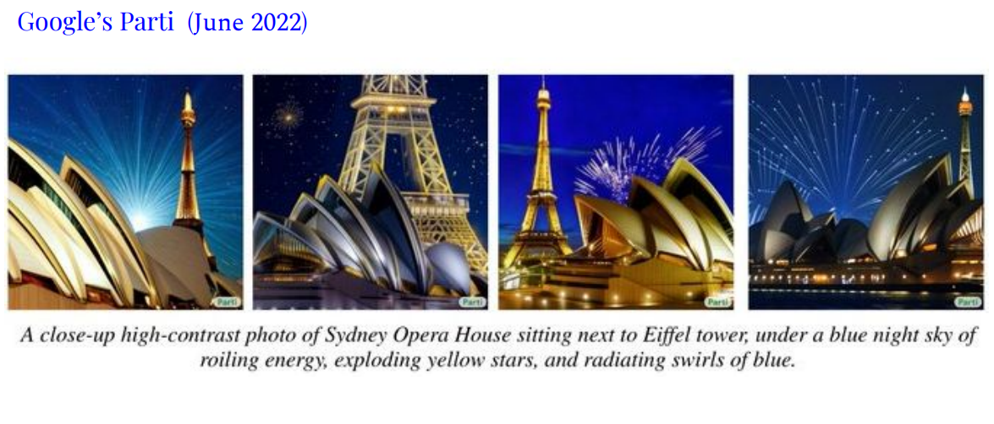

Slide 21
Machine Learning
An algorithmic way of making sense (learning) from data.

Slide 22
Forms of Learning
Any component of an agent can be improved by learning from data.
The improvements, and the techniques used to make them, depend on four major factors
  Which component is to be improved.
  What prior knowledge the agent already has.
  What representation is used for the data and the component.
  What feedback is available to learn from.

Slide 23
Components to be learned
The components of these agents include:
A direct mapping from conditions on the current state to actions.
A means to infer relevant properties of the world from the percept sequence.
Information about the way the world evolves and about the results of possible actions the agent can take.
Utility information indicating the desirability of world states.
Action-value information indicating the desirability of actions.
Goals that describe classes of states whose achievement maximizes the agent’s utility
Each of these components can be learned.

Slide 24
example
an agent training to become a taxi driver.
Every time the instructor shouts “Brake!” the agent might learn a condition– action rule for when to brake (component 1); the agent also learns every time the instructor does not shout.
By seeing many camera images that it is told contain buses, it can learn to recognize them (2).
By trying actions and observing the results—for example, braking hard on a wet road—it can learn the effects of its actions (3).
Then, when it receives no tip from passengers who have been thoroughly shaken up during the trip, it can learn a useful component of its overall utility function (4).

Slide 25
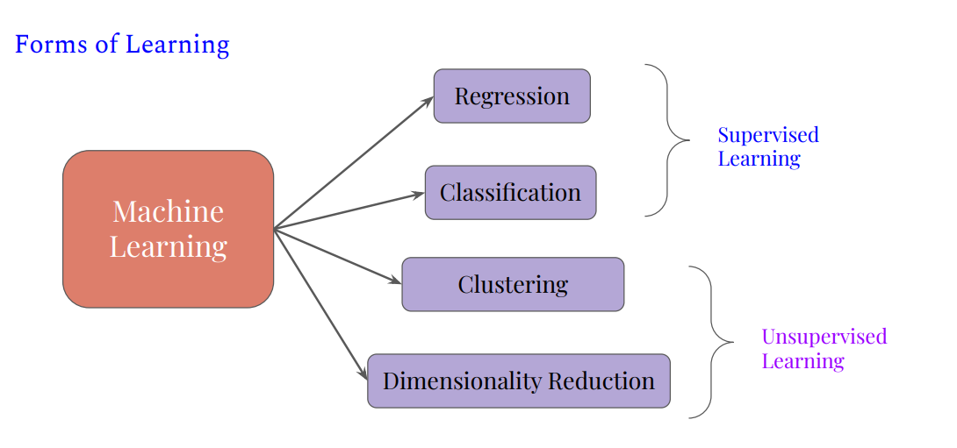

Slide 26
supervised learning
In supervised learning the machine experiences the examples along with the labels or targets for each example.
The labels in the data help the algorithm to correlate the features.
Two of the most common supervised machine learning tasks are
  classification and
  regression.

Slide 27
Classification
uses an algorithm to accurately assign test data into specific categories.
It recognizes specific entities within the dataset and attempts to draw some conclusions on how those entities should be labeled or defined.
Common classification algorithms are
  linear classifiers,
  support vector machines (SVM),
  decision trees,
  k-nearest neighbor, and
  random forest

Slide 28
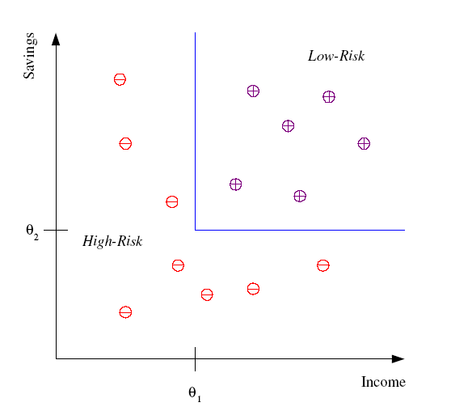
Classification example
Example: Credit scoring
Differentiating between low-risk and high-risk customers from their income and savings
Discriminant: IF income > θ₁ AND savings > θ₂
THEN low-risk ELSE high-risk

Slide 29
Regression
It is used to understand the relationship between dependent and independent variables.
It is commonly used to make projections, such as for sales revenue for a given business.
Types are
  Linear regression,
  logistical regression, and
  polynomial regression

Slide 30
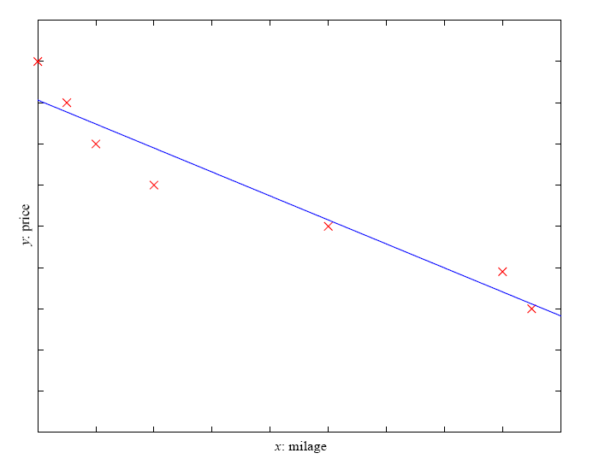
Regression example
Example: Price of a used car
x : car attributes
y : price
y = g (x | θ )
g ( ) model,
θ parameters

Slide 31
Regression Applications
Navigating a car: Angle of the steering wheel (CMU NavLab)
Kinematics of a robot arm
Response surface design

Slide 32
Unsupervised Learning
When we have unclassified and unlabeled data, the system attempts to uncover patterns from the data .
There is no label or target given for the examples.
One common task is to group similar examples together called clustering.
Example applications
  Customer segmentation in CRM
  Image compression: Color quantization
  Bioinformatics: Learning motifs

Slide 33
Unsupervised learning models are used for three main tasks:
  clustering: group data according to "distance"
  association: find frequent co-occurrences
  link prediction: discover relationships in data
  data reduction: project features to fewer features

Slide 34
Clustering
It is a data mining technique for grouping unlabeled data based on their similarities or differences.
For example, K-means clustering algorithms assign similar data points into groups, where the K value represents the size of the grouping and granularity.
This technique is helpful for market segmentation, image compression, etc.

Slide 35
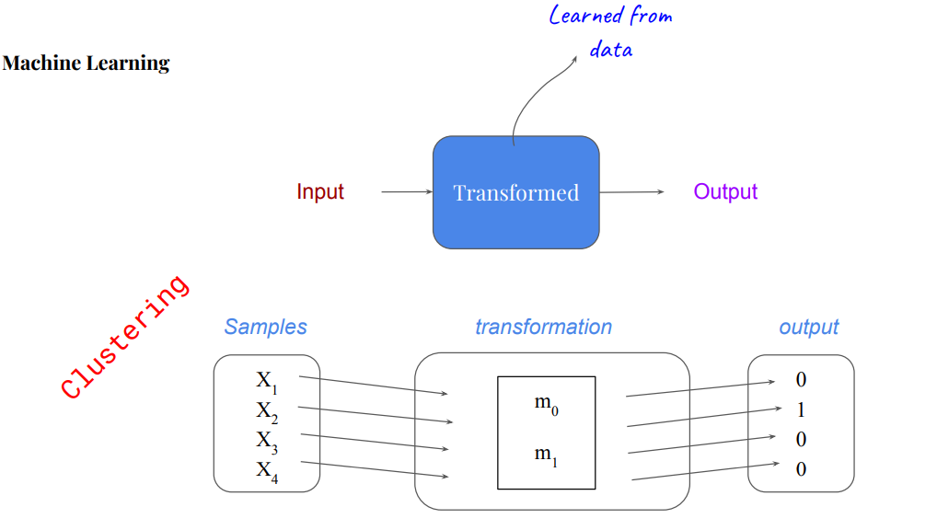

Slide 36
Dimensionality Reduction
It is a learning technique used when the number of features (or dimensions) in a given dataset is too high.
It reduces the number of data inputs to a manageable size while also preserving the data integrity.
Often, this technique is used in the preprocessing data stage, such as when autoencoders remove noise from visual data to improve picture quality.

Slide 37
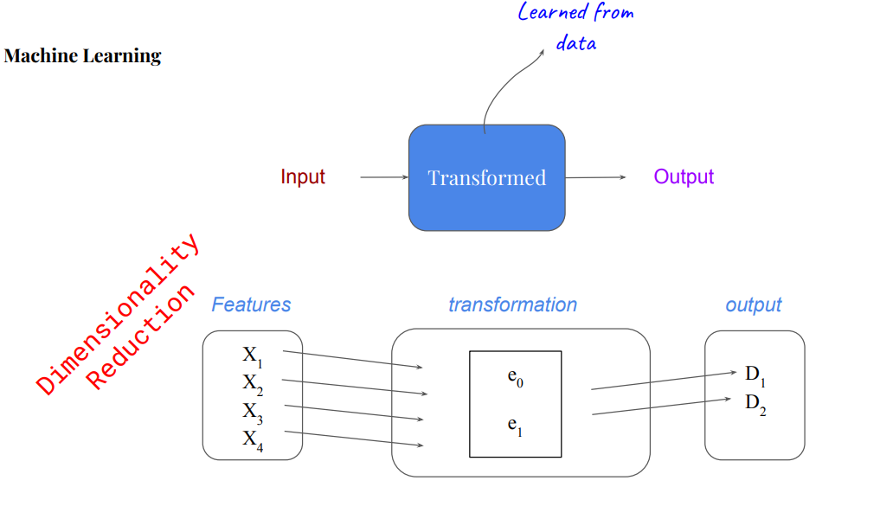

Slide 38
Association
uses different rules to find relationships between variables in a given dataset.
These methods are frequently used for market basket analysis and recommendation engines, along the lines of “Customers Who Bought This Item Also Bought” recommendations.

Slide 39
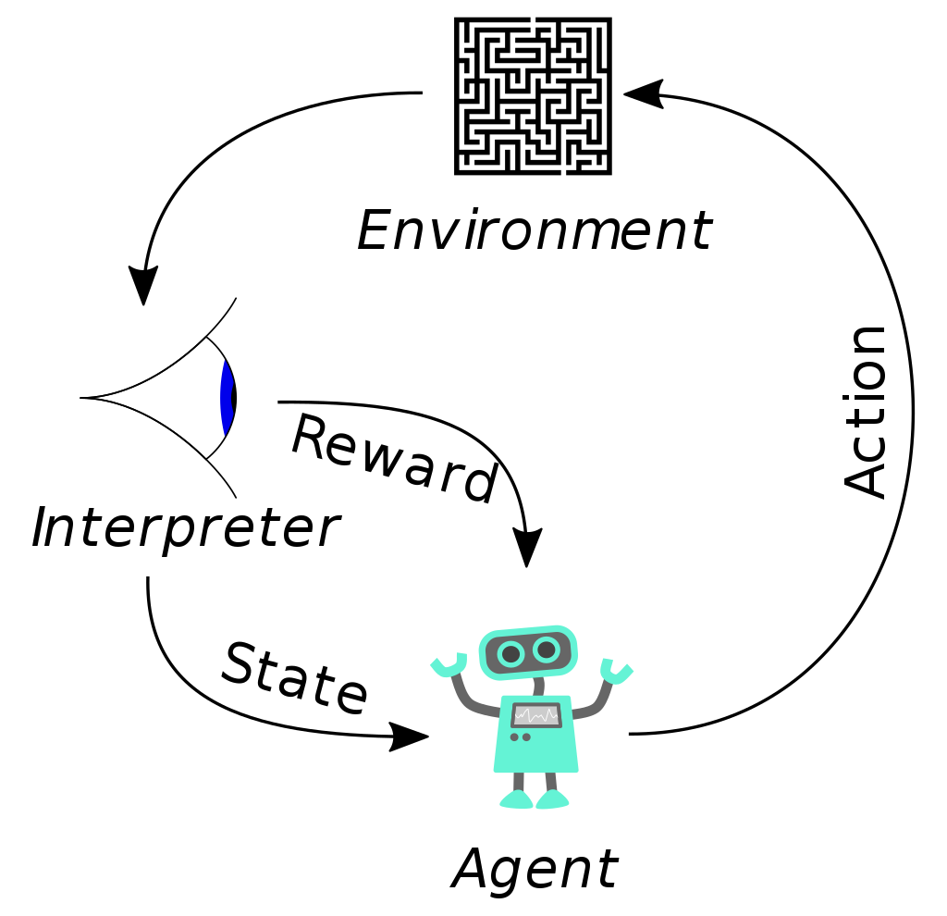
REINFORCEMENT LEARNING
Agent learns from a series of reinforcements rewards or punishments.
For example, the lack of a tip at the end of the journey gives the taxi agent an indication that it did something wrong.
The two points for a win at the end of a chess game tells the agent it did something right.
It is up to the agent to decide which of the actions prior to the reinforcement were most responsible for it.

Slide 40
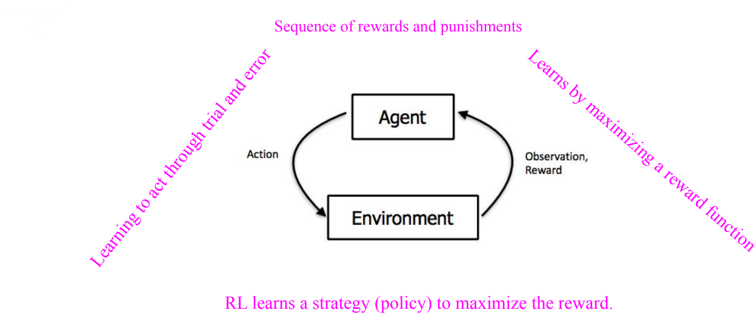

Slide 41
semi-supervised learning
In semi-supervised learning we are given a few labeled examples and must make what we can of a large collection of unlabeled examples.
Even the labels themselves may not be the oracular truths that we hope for.
Imagine that you are trying to build a system to guess a person’s age from a photo.
  You gather some labeled examples by snapping pictures of people and asking their age. That’s supervised learning.
  But in reality some of the people lied about their age.
  It’s not just that there is random noise in the data; rather the inaccuracies are systematic, and to uncover them is an unsupervised learning problem involving images, self-reported ages, and true (unknown) ages.
  Thus, both noise and lack of labels create a continuum between supervised and unsupervised learning

Slide 42
SUPERVISED LEARNING
The task of supervised learning is this
Given a training set of N example input–output pairs
(x1, y1),(x2, y2),...(xN , yN ) ,
where each y_{j} was generated by an unknown function y = f(x),
discover a function h that approximates the true function f.
Here x and y can be any value; they need not be numbers.
The function h is a hypothesis

Slide 43
Learning is a search through the space of possible hypotheses for one that will perform well, even on new examples beyond the training set.
To measure the accuracy of a hypothesis we give it a test set of examples that are distinct from the training set
a hypothesis generalizes well if it correctly predicts the value of y for novel examples.
Sometimes the function f is stochastic it is not strictly a function of x, and what we have to learn is a conditional probability distribution, P(Y | x).

Slide 44
CLASSIFICATION AND REGRESSION
When the output y is one of a finite set of values (such as sunny, cloudy or rainy), the learning problem is called classification, and is called Boolean or binary classification if there are only two values.
When y is a number (such as tomorrow’s temperature), the REGRESSION learning problem is called regression

Slide 45
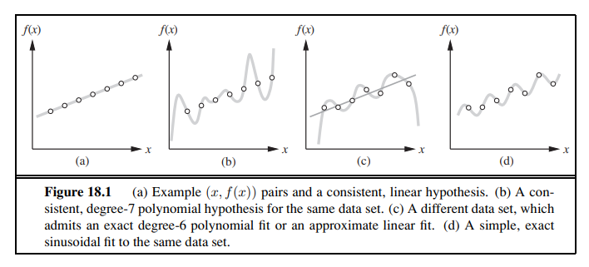

Slide 46
fitting a function of a single variable to some data points.
The examples are points in the (x, y) plane, where y = f(x).
We don’t know what f is, but we will approximate it with a function h selected from a hypothesis space, H,
which for this example we will take to be the set of polynomials, such as x⁵+3x²+2

Slide 47
shows some data with an exact fit by a straight line
The line is called a consistent hypothesis because it agrees with all the data

Slide 48
shows a high degree polynomial that is also consistent with the same data.
This illustrates a fundamental problem in inductive learning: how do we choose from among multiple consistent hypotheses?
One answer is to prefer the simplest hypothesis consistent with the data.
This principle is called Ockham’s razor, after the 14th-century English philosopher William of Ockham, who used it to argue sharply against all sorts of complications.
Defining simplicity is not easy, but it seems clear that a degree-1 polynomial is simpler than a degree-7 polynomial, and thus (a) should be preferred to (b).

Slide 49
shows a second data set.
There is no consistent straight line for this data set; in fact, it requires a degree-6 polynomial for an exact fit.
There are just 7 data points, so a polynomial with 7 parameters does not seem to be finding any pattern in the data and we do not expect it to generalize well.
A straight line that is not consistent with any of the data points, but might generalize fairly well for unseen values of x, is also shown in (c).
In general, there is a tradeoff between complex hypotheses that fit the training data well and simpler hypotheses that may generalize better

Slide 50
we expand the hypothesis space H to allow polynomials over both x and sin(x), and find that the data in (c) can be fitted exactly by a simple function of the form ax + b + c sin(x).
This shows the importance of the choice of hypothesis space.
We say that a learning problem is realizable if the hypothesis space contains the true function.
Unfortunately, we cannot always tell whether a given learning problem is realizable, because the true function is not known

Slide 51
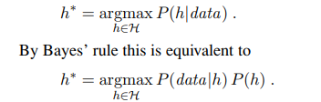
Supervised learning can be done by choosing the hypothesis h∗ that is most probable given the data:
Then we can say that the prior probability P(h) is high for a degree-1 or -2 polynomial, lower for a degree-7 polynomial, and especially low for degree-7 polynomials with large, sharp spikes as in Figure 18.1(b).
We allow unusual-looking functions when the data say we really need them, but we discourage them by giving them a low prior probability.

Slide 52
Learning Decision Tree
Decision tree induction is one of the simplest and yet most successful forms of machine learning

Slide 53
What is a decision tree?
Decision tree
  is a function that
    takes a vector of attribute values as its input, and
    returns a “decision” as its output.
    Both input and output values can be measured on a nominal, ordinal, interval, and ratio scales, can be discrete or continuous.
  The decision is formed via a sequence of tests:
    each internal node of the tree represents a test,
    the branches are labeled with possible outcomes of the test, and
    each leaf node represents a decision to be returned by the tree.

Slide 54
Terminologies
Root Nodes – It is the node present at the beginning of a decision tree from this node the population starts dividing according to various features.
Decision Nodes – the nodes we get after splitting the root nodes are called Decision Node
Leaf Nodes – the nodes where further splitting is not possible are called leaf nodes or terminal nodes
Sub-tree – just like a small portion of a graph is called sub-graph similarly a sub-section of this decision tree is called sub-tree.
Pruning – is nothing but cutting down some nodes to stop overfitting.

Slide 55
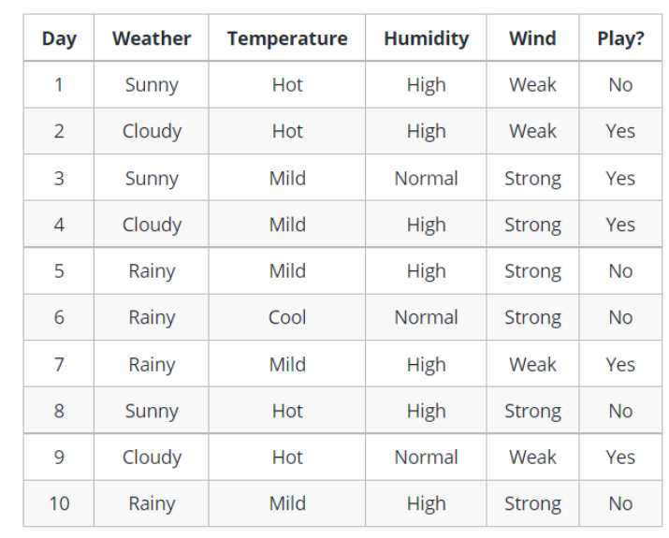
Example of a decision tree

Slide 56
Decision trees are upside down which means the root is at the top and then this root is split into various several nodes.
Decision trees are nothing but a bunch of if-else statements in layman terms.
It checks if the condition is true and if it is then it goes to the next node attached to that decision.

Slide 57
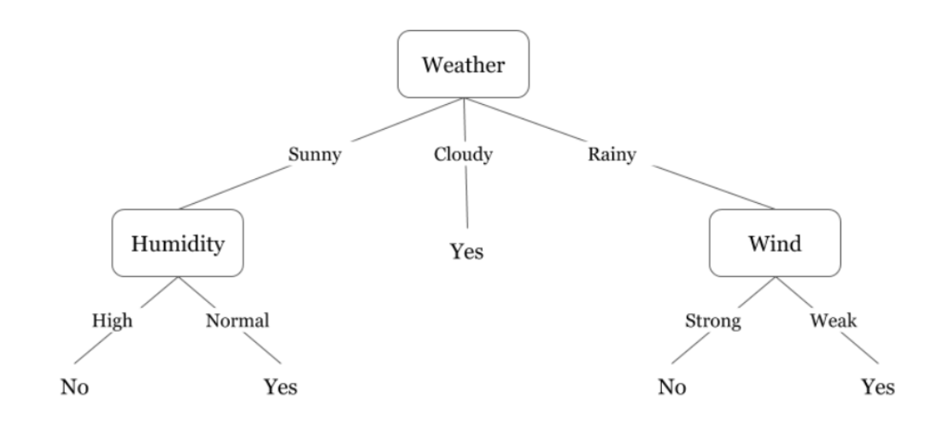
In the below diagram the tree will first ask what is the weather?
Is it sunny, cloudy, or rainy? If yes then it will go to the next feature which is humidity and wind. It will again check if there is a strong wind or weak, if it’s a weak wind and it’s rainy then the person may go and play.
We see that if the weather is cloudy then we must go to play.
Why didn’t it split more? Why did it stop there?

Slide 58
To answer this question, we need to know about few more concepts like entropy, information gain, and Gini index.
But in simple terms, I can say here that the output for the training dataset is always yes for cloudy weather, since there is no disorderliness here we don’t need to split the node further.
The goal of machine learning is to decrease uncertainty or disorders from the dataset and for this, we use decision trees.
Now you must be thinking how do I know what should be the root node? what should be the decision node? when should I stop splitting? To decide this, there is a metric called “Entropy” which is the amount of uncertainty in the dataset.

Slide 59
Entropy
Entropy is nothing but the uncertainty in our dataset or measure of disorder. Let me try to explain this with the help of an example.
Suppose you have a group of friends who decides which movie they can watch together on Sunday.
  There are 2 choices for movies, one is “Lucy” and the second is “Titanic” and now everyone has to tell their choice.
  After everyone gives their answer we see that “Lucy” gets 4 votes and “Titanic” gets 5 votes.
  Which movie do we watch now?
  Isn’t it hard to choose 1 movie now because the votes for both the movies are somewhat equal.

Slide 60
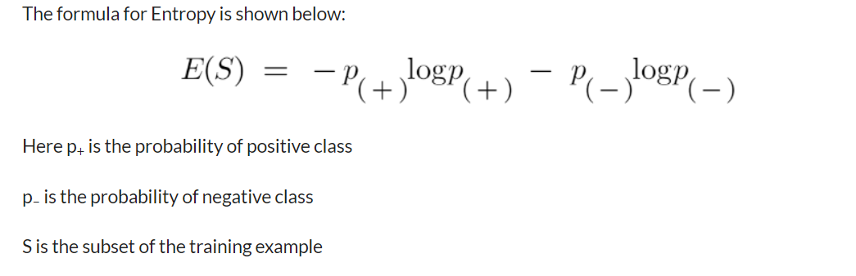
This is exactly what we call disorderness, there is an equal number of votes for both the movies, and we can’t really decide which movie we should watch.
It would have been much easier if the votes for “Lucy” were 8 and for “Titanic” it was 2.
Here we could easily say that the majority of votes are for “Lucy” hence everyone will be watching this movie.
In a decision tree, the output is mostly “yes” or “no”

Slide 61
How do Decision Trees use Entropy?
Entropy basically measures the impurity of a node. Impurity is the degree of randomness; it tells how random our data is. A pure sub-split means that either you should be getting “yes”, or you should be getting “no”.
Suppose a feature has 8 “yes” and 4 “no” initially, after the first split the left node gets 5 ‘yes’ and 2 ‘no’ whereas right node gets 3 ‘yes’ and 2 ‘no’.
We see here the split is not pure, why? Because we can still see some negative classes in both the nodes. In order to make a decision tree, we need to calculate the impurity of each split, and when the purity is 100%, we make it as a leaf node.

Slide 62
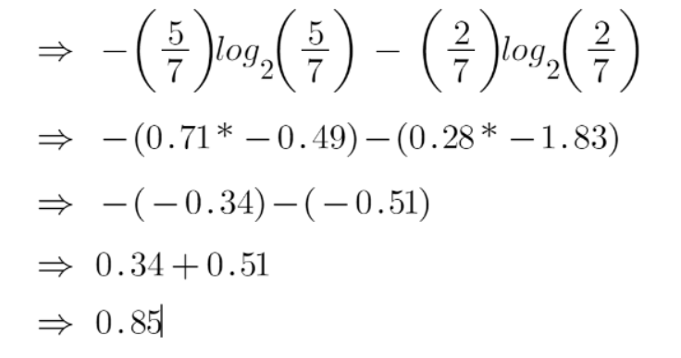
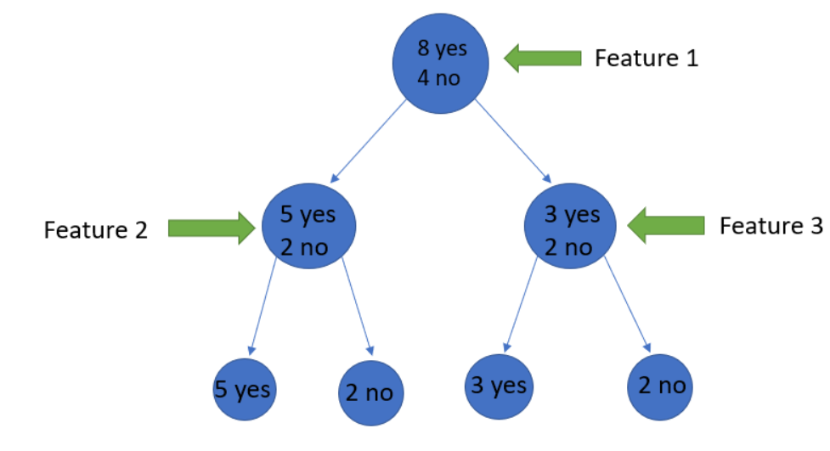
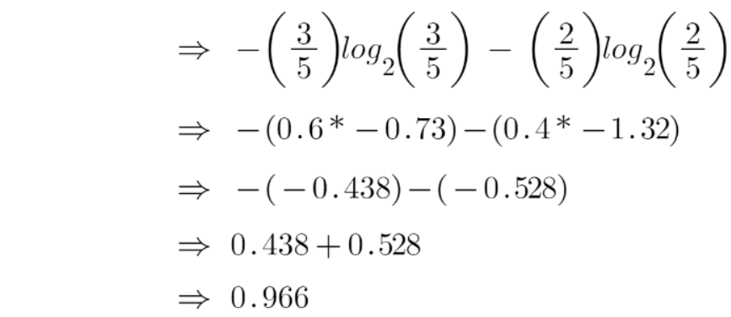
To check the impurity of feature 2 and feature 3 we will take the help for Entropy formula.
Feature 2
Feature 3

Slide 63
We can clearly see from the tree itself that left node has low entropy or more purity than right node since left node has a greater number of “yes” and it is easy to decide here.
Always remember that the higher the Entropy, the lower will be the purity and the higher will be the impurity.
As mentioned earlier the goal of machine learning is to decrease the uncertainty or impurity in the dataset, here by using the entropy we are getting the impurity of a particular node, we don’t know if the parent entropy or the entropy of a particular node has decreased or not
For this, we bring a new metric called “Information gain” which tells us how much the parent entropy has decreased after splitting it with some feature.

Slide 64

Information Gain
Information gain measures the reduction of uncertainty given some feature and it is also a deciding factor for which attribute should be selected as a decision node or root node.
It is just entropy of the full dataset – entropy of the dataset given some feature.

Slide 65
Example
Suppose our entire population has a total of 30 instances. The dataset is to predict whether the person will go to the gym or not. Let’s say 16 people go to the gym and 14 people don’t
Now we have two features to predict whether he/she will go to the gym or not.
Feature 1 is “Energy” which takes two values “high” and “low”
Feature 2 is “Motivation” which takes 3 values “No motivation”, “Neutral” and “Highly motivated”.
Let’s see how our decision tree will be made using these 2 features. We’ll use information gain to decide which feature should be the root node and which feature should be placed after the split.

Slide 66
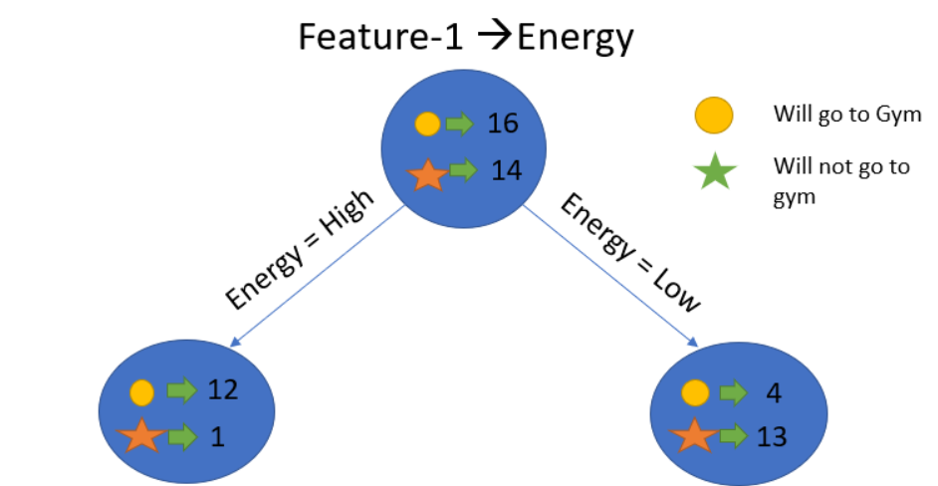
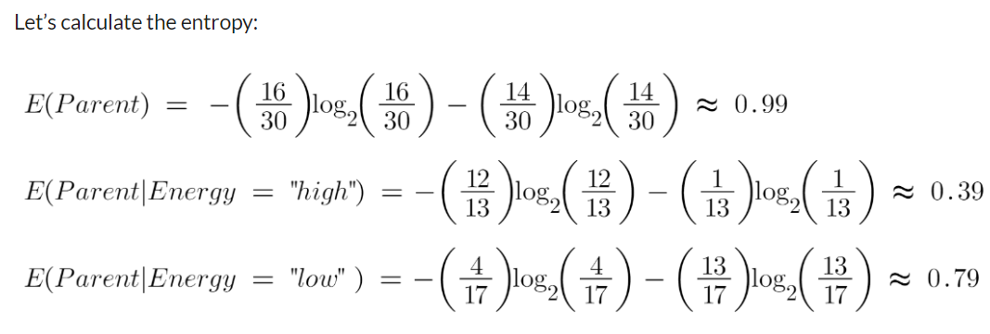

Slide 67
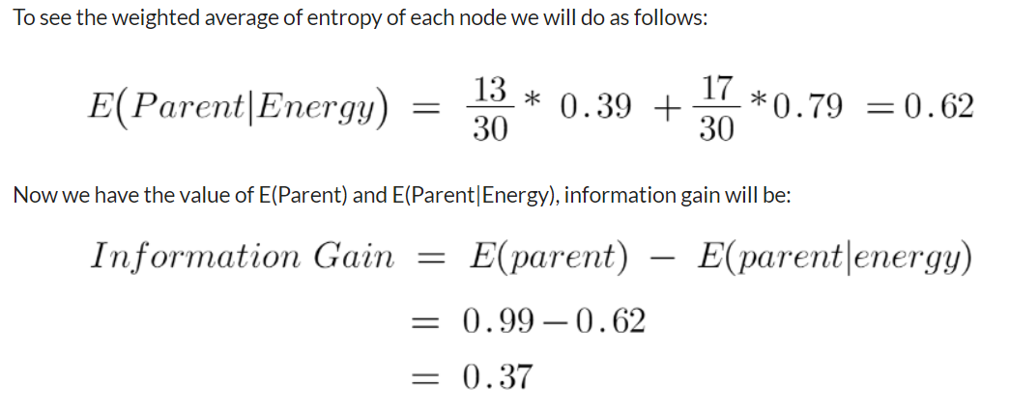

Slide 68
Our parent entropy was near 0.99 and after looking at this value of information gain, we can say that the entropy of the dataset will decrease by 0.37 if we make “Energy” as our root node.
Similarly, we will do this with the other feature “Motivation” and calculate its information gain.

Slide 69
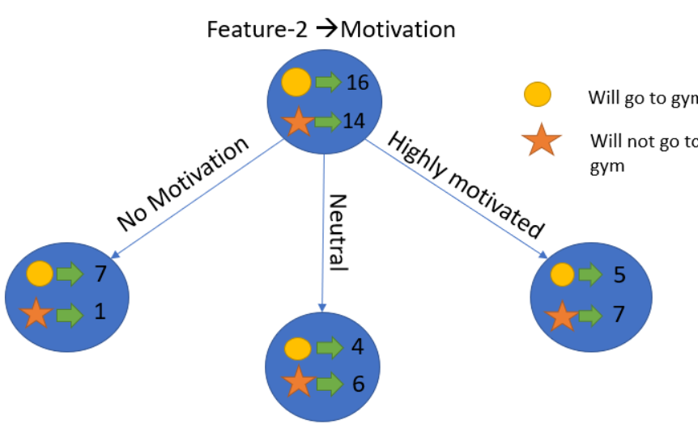
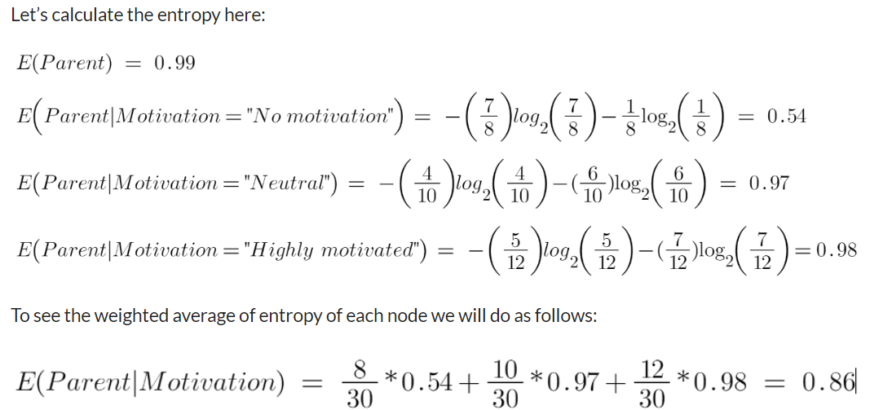

Slide 70
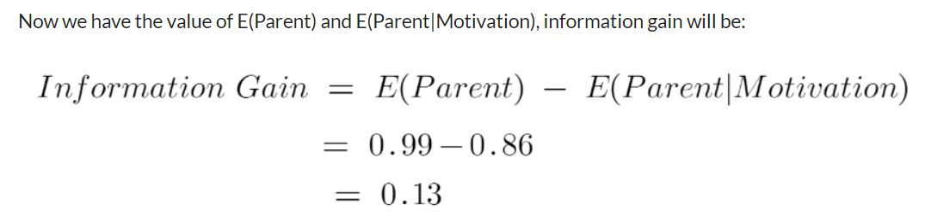

Slide 71
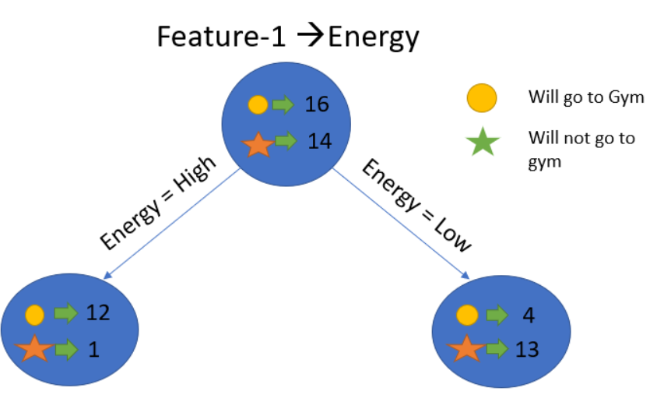
We now see that the “Energy” feature gives more reduction which is 0.37 than the “Motivation” feature.
Hence we will select the feature which has the highest information gain and then split the node based on that feature.
In this example “Energy” will be our root node and we’ll do the same for sub-nodes.
Here we can see that when the energy is “high” the entropy is low and hence we can say a person will definitely go to the gym if he has high energy, but what if the energy is low?
We will again split the node based on the new feature which is “Motivation”.

Slide 72
The decision tree representation
A decision tree represents a function that takes as input a vector of attribute values and returns a “decision”—a single output value.
The input and output values can be discrete or continuous
For now we will concentrate on problems where the inputs have discrete values and the output has exactly two possible values;
this is Boolean classification, where each POSITIVE example input will be classified as true (a positive example) or false (a negative example).

Slide 73

A decision tree reaches its decision by performing a sequence of tests.
Each internal node in the tree corresponds to a test of the value of one of the input attributes, Ai, and the branches from the node are labeled with the possible values of the attribute, Ai = vik.
Each leaf node in the tree specifies a value to be returned by the function.
The decision tree representation is natural for humans; indeed, many “How To” manuals (e.g., for car repair) are written entirely as a single decision tree stretching over hundreds of pages

Slide 74
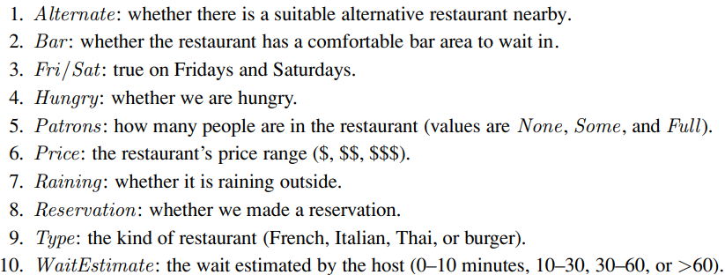
Example
we will build a decision tree to decide whether to wait for a table at a GOAL PREDICATE restaurant.
The aim here is to learn a definition for the goal predicate WillWait.
First we list the attributes that we will consider as part of the input:

Slide 75
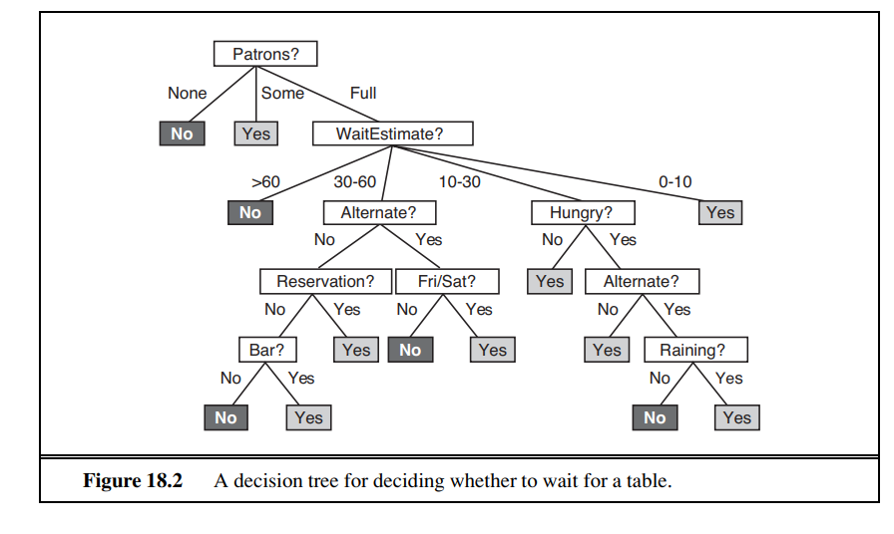

Slide 76
Note that every variable has a small set of possible values;
the value of WaitEstimate, for example, is not an integer, rather it is one of the four discrete values 0–10, 10–30, 30–60, or >60.
Notice that the tree ignores the Price and Type attributes.
Examples are processed by the tree starting at the root and following the appropriate branch until a leaf is reached.
For instance, an example with Patrons = Full and WaitEstimate = 0–10 will be classified as positive (i.e., yes, we will wait for a table).

Slide 77
Expressiveness of decision trees
A Boolean decision tree is logically equivalent to the assertion that the goal attribute is true if and only if the input attributes satisfy one of the paths leading to a leaf with value true.
Writing this out in propositional logic, we have Goal ⇔ (Path1 ∨ Path2 ∨···) ,
where each Path is a conjunction of attribute-value tests required to follow that path.
Thus, the whole expression is equivalent to disjunctive normal form, which means that any function in propositional logic can be expressed as a decision tree.
As an example, the rightmost path in Figure is
  Path = (Patrons = Full ∧ WaitEstimate = 0–10) .

Slide 78
Inducing decision trees from examples
An example for a Boolean decision tree consists of an (x, y) pair, where x is a vector of values for the input attributes, and y is a single Boolean output value.
The positive examples are the ones in which the goal WillWait is true (x1, x3,...); the negative examples are the ones in which it is false (x2, x5,...).

Slide 79
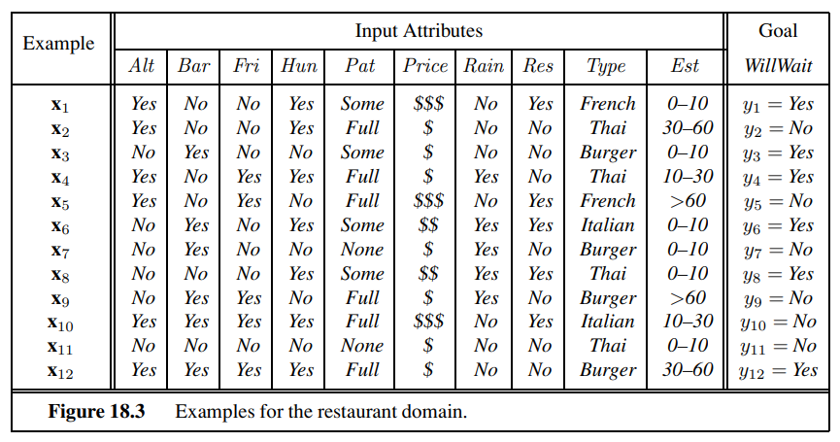
A training set of 12 examples is shown below

Slide 80
We want a tree that is consistent with the examples and is as small as possible.
Unfortunately, no matter how we measure size, it is an intractable problem to find the smallest consistent tree; there is no way to efficiently search through the 2^{2n} trees.
With some simple heuristics, however, we can find a good approximate solution: a small (but not smallest) consistent tree.
The DECISION-TREE-LEARNING algorithm adopts a greedy divide-and-conquer strategy: always test the most important attribute first.
This test divides the problem up into smaller subproblems that can then be solved recursively

Slide 81
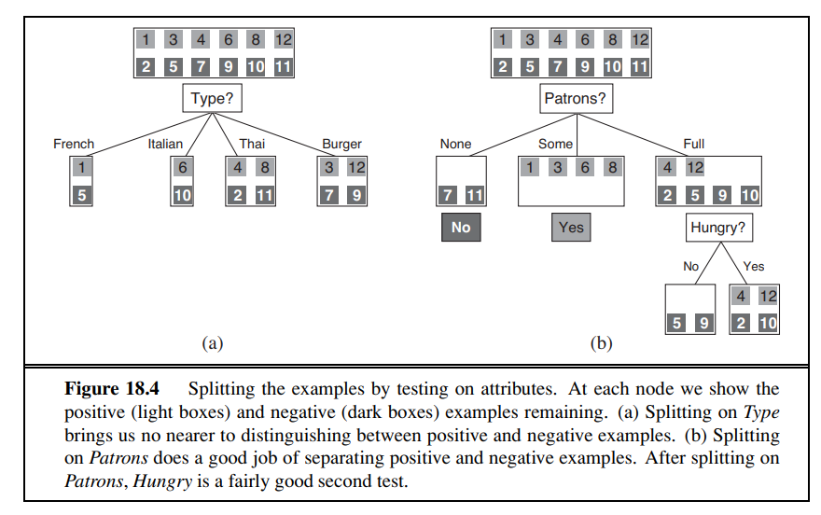

Slide 82
Figure shows that Type is a poor attribute, because it leaves us with four possible outcomes, each of which has the same number of positive as negative examples.
On the other hand, in (b) we see that Patrons is a fairly important attribute, because if the value is None or Some, then we are left with example sets for which we can answer definitively (No and Yes, respectively).
If the value is Full, we are left with a mixed set of examples.
In general, after the first attribute test splits up the examples, each outcome is a new decision tree learning problem in itself, with fewer examples and one less attribute.

Slide 83
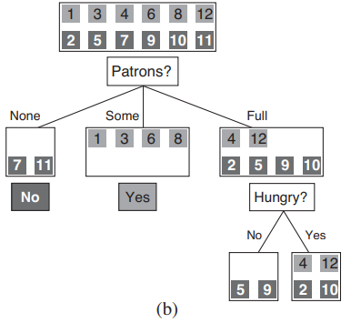
There are four cases to consider for these recursive problems:
If the remaining examples are all positive (or all negative), then we are done: we can answer Yes or No. Figure 18.4(b) shows examples of this happening in the None and Some branches.

Slide 84
If there are some positive and some negative examples, then choose the best attribute to split them. Figure 18.4(b) shows Hungry being used to split the remaining examples

Slide 85
If there are no examples left, it means that no example has been observed for this combination of attribute values, and we return a default value calculated from the plurality classification of all the examples that were used in constructing the node’s parent.
  These are passed along in the variable parent examples.
If there are no attributes left, but both positive and negative examples,
  it means that these examples have exactly the same description, but different classifications.
  This can NOISE happen because there is an error or noise in the data; because the domain is nondeterministic; or because we can’t observe an attribute that would distinguish the examples.
  The best we can do is return the plurality classification of the remaining examples.

Slide 86
plurality classification
majority class if there were only two classes.
Plurality is just the generalization of majority to more than 2 classes.
It just means take the most frequent class in that leaf and return that as your prediction.
For example, if you are classifying the colors of balls, and there are 3 blue balls, 2 red balls, and 2 white balls in a leaf, return blue as your prediction.

Slide 87
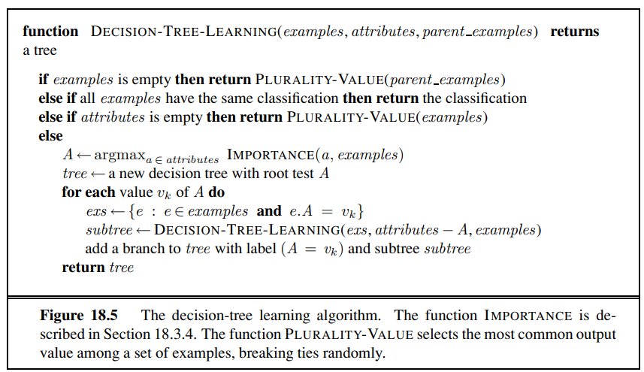
DECISION-TREE-LEARNING algorithm

Slide 88
the set of examples is crucial for constructing the tree, but nowhere do the examples appear in the tree itself.
A tree consists of just tests on attributes in the interior nodes, values of attributes on the branches, and output values on the leaf nodes

Slide 89
A training set of 12 examples is shown below

Slide 90
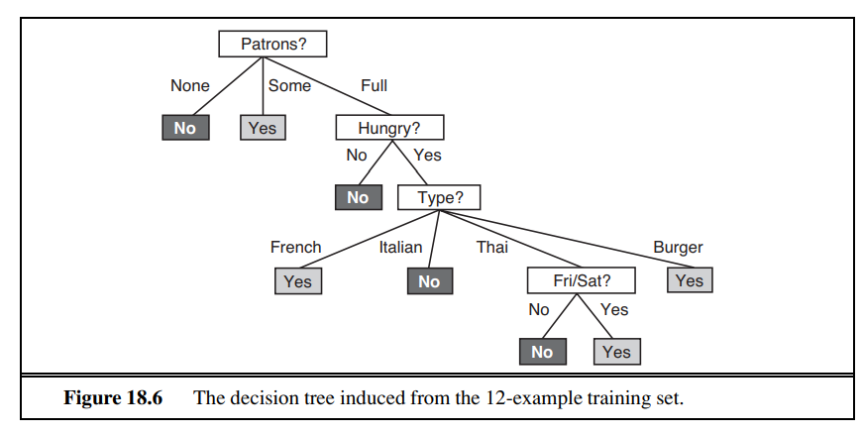

Slide 91
Three step process to solve a problem using decision tree
Position the best attribute of the dataset at the root of the tree
Split the dataset or training set into subsets such that each subset contains the homogenous data in other words it contains data having some value for an attribute
Repeat step 1 and step 2 on each subset until we find leaf node in all the branch of tree

Slide 92
Various Decision Tree Algorithms
ID3(Iterative Dichotomiser 3)
C4.5
C5.0
CART(Classification and Regression Tree)
1R(One Rule)
RIPPER(Repeated Incremented Pruning to Produce Error Reduction)

Slide 93
Dataset S
Day | Outlook | Temperature | Humidity | Wind | Play Tennis
D1 | SUNNY | HOT | HIGH | WEAK | No
D2 | SUNNY | HOT | HIGH | STRONG | No
D3 | OVERCAST | HOT | HIGH | WEAK | Yes
D4 | RAIN | MILD | HIGH | WEAK | Yes
D5 | RAIN | COOL | NORMAL | WEAK | Yes
D6 | RAIN | COOL | NORMAL | STRONG | No
D7 | OVERCAST | COOL | NORMAL | STRONG | Yes
D8 | SUNNY | MILD | HIGH | WEAK | No
D9 | SUNNY | COOL | NORMAL | WEAK | Yes
D10 | RAIN | MILD | NORMAL | WEAK | Yes
D11 | SUNNY | MILD | NORMAL | STRONG | Yes
D12 | OVERCAST | MILD | HIGH | STRONG | Yes
D13 | OVERCAST | HOT | NORMAL | WEAK | Yes
D14 | RAIN | MILD | HIGH | STRONG | No

Slide 94
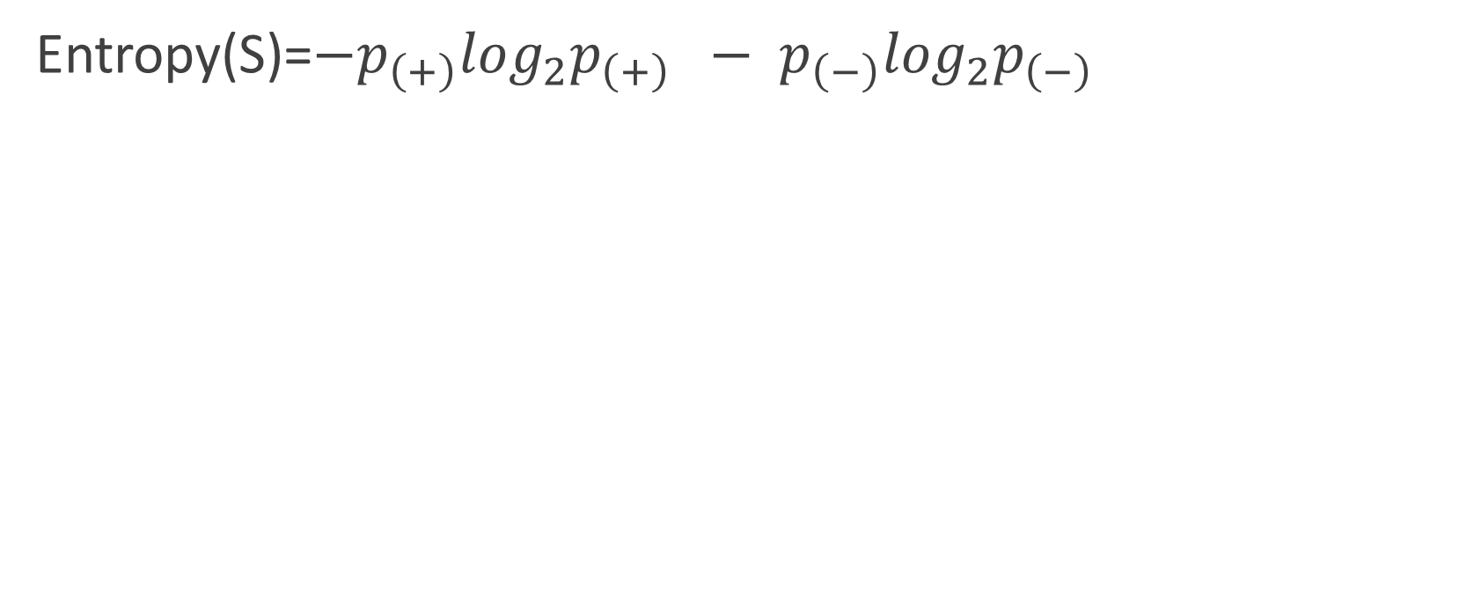
Step 1: Calculate Entropy
Entropy(S)=$−p_{\left(+\right)}\log_{2}p_{\left(+\right)} − p_{\left(−\right)}\log_{2}p_{\left(−\right)}$

Slide 96

MODULE 3 ENDS
THANK YOU

